Slide 1



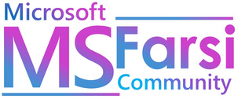
CLOUD MIGRATION SERVICES
Presented By : Group #3

Slide 2

01
WHAT IS CLOUD MIGRATION?
02
SCENARIO
TABLE OF CONTENT
03
KEY STEPS IN THE CLOUD MIGRATION PROCESS
04
ASSESSMENT
05
PLANNING
06
MIGRATION
07
OPTIMIZATION

Slide 3





WHAT IS CLOUD MIGRATION?
Cloud Migration Defined: Transition of IT resources, applications, and data to cloud platforms.
Key Advantage: Flexible and efficient access to computing resources.
Performance: Access to high-performance computing and storage solutions.
Global Access: Anywhere, anytime access for distributed teams.
DEFINITION
TYPES OF CLOUD
CLOUD PLATFORMS

Slide 4

SCENARIO
Migration Strategy: Design an effective plan using Azure services to ensure seamless database and .NET application migration with data integrity.
Monitoring Setup: Implement active monitoring with dashboards for key metrics like CPU, memory, and performance.
Alerting & Scalability: Configure alerts for resource usage above 50% and ensure the solution scales with growing traffic and data needs.

Slide 5

KEY STEPS IN THE CLOUD MIGRATION PROCESS
01
ASSESSMENT
03
MIGRATION
02
PLANNING
04
OPTIMIZATION

Slide 6

ASSESSMENT
Web Application Review: Analyzing the .Net App architecture and dependencies for hosting on Azure App Service.
Database Evaluation: Assessing compatibility with Azure SQL Database for security and scalability.
Migration Tools: Azure Migrate to map dependencies, assess compatibility, and estimate resources for a smooth transition.

Slide 7
PLANNING
App Migration: Move ASP.NET app to Azure App Service for scalability.
SQL Migration: Use Azure Database Migration Service for secure data transfer.
Blob Storage: Store video content with efficient integration.
Autoscaling: Configure for workload flexibility and cost efficiency.
Security & Monitoring: Implement NSGs and Azure Monitor for traffic security and performance tracking.

Slide 8
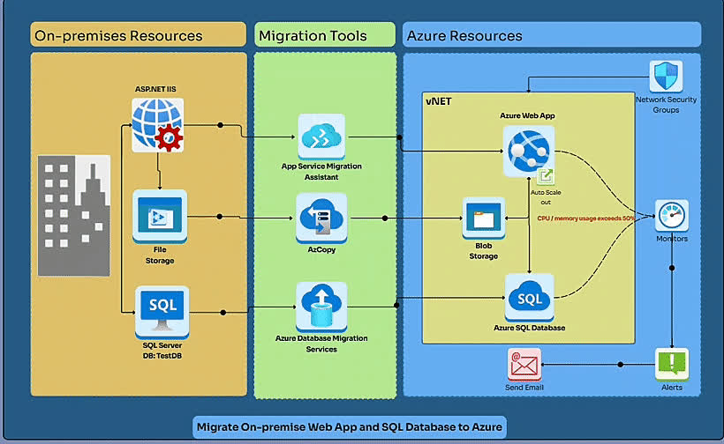
PLANNING

Slide 9
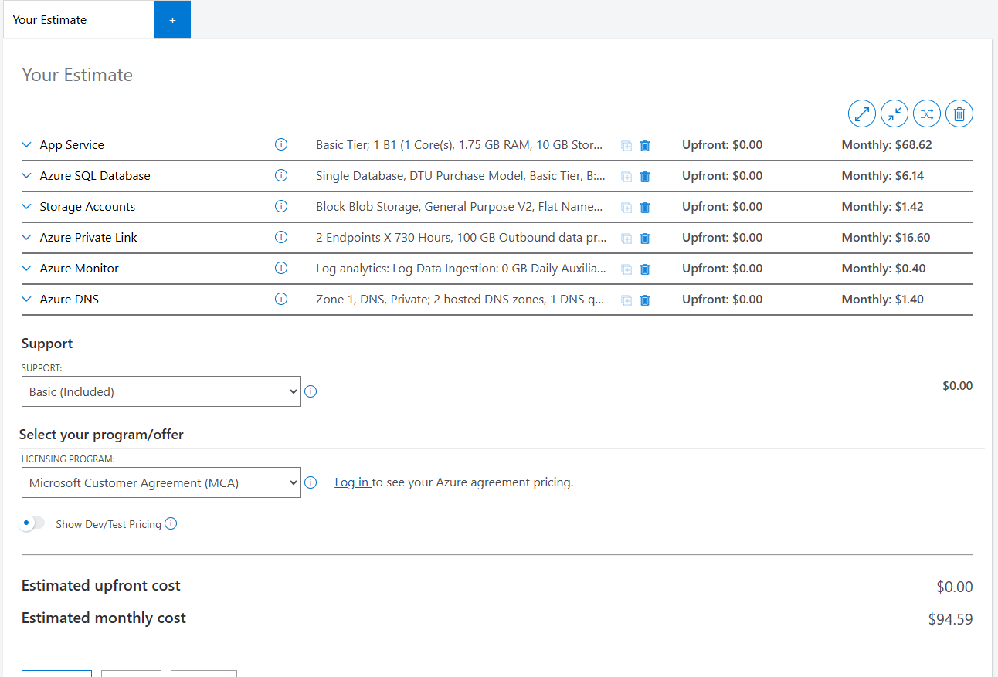
PLANNING

Slide 10

LET’S TAKE A BREAK

Slide 11

MIGRATION

Slide 12

OPTIMIZATION
WAF
Security: Azure Defender for SQL.
Online Migration: Minimal downtime for SQL Server to Azure SQL Managed Instance.
High Availability: Failover groups and storage redundancy.

Slide 13
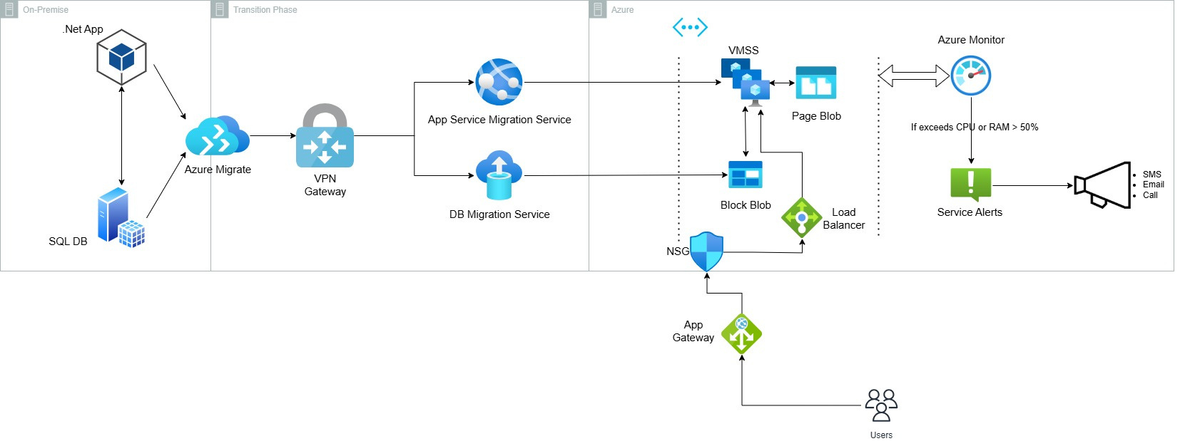
OPTIMIZATION

Slide 14
THANK YOU

